Slide 1

Natural Language Processing
Rohit Kate
Linguistics Essentials – Part 1
Reading: Chapter 3, Textbook 2

Slide 2
Need for Linguistics in NLP
To make computers do an NLP task it is helpful to aid it with some knowledge about the language
Example: In the entity extraction task, the entities are almost always nouns so the extraction task can be narrowed to only nouns
But then the question is how to identify nouns in a sentence (including never before seen)? There are linguistic rules for that.
Part-of-speech tags and other information are often used as features to train machine learning methods for NLP
Although it is not common now with deep learning
Linguistic insights can lead to better machine learning system designs for NLP
Note: Some NLP systems bypass linguistic features and learn to perform the task only from data
It is possible that they implicitly learn linguistic information in the process
Incorporating linguistics may be necessary for more complex tasks

Slide 3
Linguistics
Study of language, its form, structure, aspects, etc.
What forms a correct sentence? What are the different labguage components (words, phrases, sentences)? etc.
Not about learning to speak the language itself
Done by linguists (for a very long time)
Reviewing written documents, interviewing native speakers
Now also by computational linguists
Analyze text data
They may add or revise linguistic categories or labels to better meet the needs of automated processing

Slide 4
Overview
We will look at a few linguistic concepts which are relevant for NLP
Words and part-of-speech tags
Phrases
Subcategorization
Lexical dependency

Slide 5
Words
Words are often considered the smallest unit of language, but linguists also define:
Lemma (also “root” or “base”) – the canonical form of a word as a string, without any derived variations
computational -> compute
computing -> compute
Lexeme – the word and all its derived and inflected forms (e.g. walk, walks, walked, walking….)
Morphemes – smallest units that carry meaning, including words, prefixes (e.g. –un-) and suffixes (-ness)
And, NLP defines other units:
Stem – any substring of a word used in an NLP system, but it may not be linguistically meaningful, e.g. stem(biker) = bik
Token – an instance of a word as it occurs in text

Slide 6
Word-Related NLP Tasks
The task of converting words to their lemmas is called lemmatization (lemmatizer)
computational -> compute
computing -> compute
Study of internal structure of words (e.g. finding morphemes) is called morphology (morphological analyzer)
carried ⇒ carry + ed (past tense)
independently ⇒ in + (depend + ent) + ly
English has relatively simple morphology, some other languages like German or Finnish have complex word structures

Slide 7
Word-Related NLP Tasks
The task of obtaining stems of words is called stemming (stemmer)
computational -> comput
computing -> comput
The task of determining tokens in text is called tokenization (tokenizer)
Not always as trivial as “separated by spaces” (dashes, multi-word tokens etc. make it harder)
Harder to segment words written in some languages like Chinese

Slide 8
Parts of Speech
Linguists group words of a language into categories which occur in similar places in a sentence and have similar type of meaning, these are called parts of speech (POS)
Familiar parts of speech (POS) include:
Noun, verb, adjective, adverb, preposition, pronoun, determiner (article), conjunction, etc.
They generally exist across all languages
A basic test to see if words belong to the same category or not is the substitution test
This is a good [dog/chair/pencil].
This is a [good/bad/green/tall] chair.

Slide 9
Parts of Speech
One could further categorize these to make finer distinction;
NLP uses some extra categories to capture features, such as number or tense, e.g. NNS = plural noun
As many as 80 categories have been used although later they were found to be too fine-grained and were reduced to around 35
There are no standard categories agreed by linguists

Slide 10
Nouns
Proper nouns (John, Mary)
English capitalizes them, but capitalization is also used at the start of a sentence.
Common nouns (goat, cheese)
Count: have plurals, get counted: goat/goats, one goat, two goats
Mass: don’t get counted (water, snow - But not: two snows)
Nouns are considered open class, i.e. there is no fixed set and more can be created
An NLP system must be designed to handle unseen nouns
Notes:
Not even the open class words all act alike. For example, we know there are at least four different types of nouns.
A proper noun is a name of a person or place; we can’t tell how its meaning fits into a concept hierarchy unless someone tells us. For example, Pheonix might be a person or a city in Arizona.
In English, proper nouns all start with a capital letter, and almost never have a determiner or any adjectives in front of them. (One exception is “The Ohio State University”, which always sounds silly to me.)
A common noun names a general type of person, place or thing. Because they name types, they often require a determiner and are often modified with adjectives to further specify the entity one is talking about.
Within the general set of common nouns are two subtypes: count nouns and mass nouns. Count nouns refer to things we can count. So they always have a determiner except in their plural form.
The word “cat” is a count noun; we say “the cat is sitting”; but “cats are sneaky.”
Mass nouns don’t get counted because they refer to the entire collection of something; substances like snow and salt are examples of mass nouns. Plants that grow as an entire field of something (like grass or wheat) are also mass nouns.
Note, you may be able to think of something that sounds like an exception; generally what you are noticing is that there may be two different senses of a word. For example, we might use “beer” to refer to the substance when we are describing a vat or truckload of the stuff, but we can treat it as a count noun if we are talking about a single serving such as a glass or a can of it.
Adverbs are an odd class; we like to think of them as simple modifiers of verbs; these are the ones that end in “ly”.
However, somewhere along the way, adverbs became a catch all term for words that might provide a direction, location, or time for a verb. These would include words like here, downhill or today We also have adverbs that are used to measure or add intensity such as very, extremely, slightly, or somewhat
And, there are adverbs that describe the manner of some activity, such as slowly or quickly.
Verbs can be main verbs (which are open class) can occur as the only verb and will have a different ending or different form to specify a different tense or number feature.
Auxilliary verbs, which you might have learned as “helping verbs”, are little verbs before the main verb that can also be used to designate a tense or a modality. They too have different subtypes over which we can define legal sequences. So you can say “She would have been able to go” but not “She have would been able to go”. In this example, would, have and been are all auxilliaries.

Slide 11
Pronouns
Pronouns: Variables or place-holders for nouns
Nominative: I, you, he, she, we, they, it
Accusative: me, you, him, her, us, them, it
Possessive: my, your, his, her, our, their, its
2nd Possessive: mine, yours, his, hers, ours, theirs, its
Reflexive: myself, yourself, himself, herself, ourselves, themselves, itself
They are closed class (the set of pronouns are fixed in a language)

Slide 12
NLP Task: Pronoun Resolution
John put the cherry on the plate and ate it.
John put the cherry on the cake and ate it.
John met Jim in the park. He gave him a book.
Pronouns need to be resolved before a sentence can be further analyzed.

Slide 13
Verbs
Main verbs name the action, state, or event; they can have a tense and require arguments (subcategorization)
Open class; new verbs can be created, e.g. “xerox”, “google”
Auxiliary verbs are used to form tenses or specify a modality i.e. possible situations (e.g. “should study” “must take a walk”); the latter we call “modals”
Closed class
Often treated as a separate POS by NLP systems
Notes:
Not even the open class words all act alike. For example, we know there are at least four different types of nouns.
A proper noun is a name of a person or place; we can’t tell how its meaning fits into a concept hierarchy unless someone tells us. For example, Pheonix might be a person or a city in Arizona.
In English, proper nouns all start with a capital letter, and almost never have a determiner or any adjectives in front of them. (One exception is “The Ohio State University”, which always sounds silly to me.)
A common noun names a general type of person, place or thing. Because they name types, they often require a determiner and are often modified with adjectives to further specify the entity one is talking about.
Within the general set of common nouns are two subtypes: count nouns and mass nouns. Count nouns refer to things we can count. So they always have a determiner except in their plural form.
The word “cat” is a count noun; we say “the cat is sitting”; but “cats are sneaky.”
Mass nouns don’t get counted because they refer to the entire collection of something; substances like snow and salt are examples of mass nouns. Plants that grow as an entire field of something (like grass or wheat) are also mass nouns.
Note, you may be able to think of something that sounds like an exception; generally what you are noticing is that there may be two different senses of a word. For example, we might use “beer” to refer to the substance when we are describing a vat or truckload of the stuff, but we can treat it as a count noun if we are talking about a single serving such as a glass or a can of it.
Adverbs are an odd class; we like to think of them as simple modifiers of verbs; these are the ones that end in “ly”.
However, somewhere along the way, adverbs became a catch all term for words that might provide a direction, location, or time for a verb. These would include words like here, downhill or today We also have adverbs that are used to measure or add intensity such as very, extremely, slightly, or somewhat
And, there are adverbs that describe the manner of some activity, such as slowly or quickly.
Verbs can be main verbs (which are open class) can occur as the only verb and will have a different ending or different form to specify a different tense or number feature.
Auxilliary verbs, which you might have learned as “helping verbs”, are little verbs before the main verb that can also be used to designate a tense or a modality. They too have different subtypes over which we can define legal sequences. So you can say “She would have been able to go” but not “She have would been able to go”. In this example, would, have and been are all auxilliaries.

Slide 14
Adjectives, Adverbs, Determiners
Adjectives: Describe properties or qualities of nouns
good, bad, green, tall
Adverbs: Modify verbs by specifying manner, degree, or intensity
often, slowly, very
Determiners: Describe particular reference of a noun
Articles: a, an, the
Demonstratives: this, that, these, those

Slide 15
Prepositions and Particles
Prepositions: They occur before nouns (or noun phrases) to form a unit (noun phrase)
in, on, over, of, about, to, with
They introduce prepositional phrases that typically introduce ambiguity in a sentence.
I saw a man on the hill with a telescope.
Prepositional phrase attachment is an important NLP problem
Particles: Subclass of prepositions that bond with verbs to form phrasal verbs
take off, air out, ran up

Slide 16
Tagsets
Tagsets are predefined, but there is not one set that is accepted as a standard.
Larger, more specific, sets are used for reduce ambiguity.
The “Penn TreeBank tagset” has about 35 word tags: PRP$, WRB, WP$, VBG etc. A verb ending in -ing has its own tag (VBG) and more phrase tags.
https://www.ling.upenn.edu/courses/Fall_2003/ling001/penn_treebank_pos.html
Smaller tagsets are used for simpler tasks
The Universal Dependency tagset has 16 tags (across 100+ languages)
https://universaldependencies.org/u/pos/
Notes:
Many systems have been created that attempt to do automated tagging; to be useful, they need to pick tags from a tagset that will capture the most interesting and useful distinctions.
A set of 4-5 tags is too coarse.
The most commonly used tagset now is the Penn Treebank tagset which contains 45 tags; these tags specify both the broad syntactic class along with the most interesting features (like possessiveness); PRP$ is possessive pronoun (like his) ; WRB is a wh-adverb (like where); WP$ is a possessive WH pronoun (whose), VBG is a gerund (like “walking”)
45 may seem like a lot, but there are even more fine-grained tagsets; The current CLAWS tagset has about 160 tags; one tagset developed for Greek had over 1000 tags (Derose 1990).

Slide 17
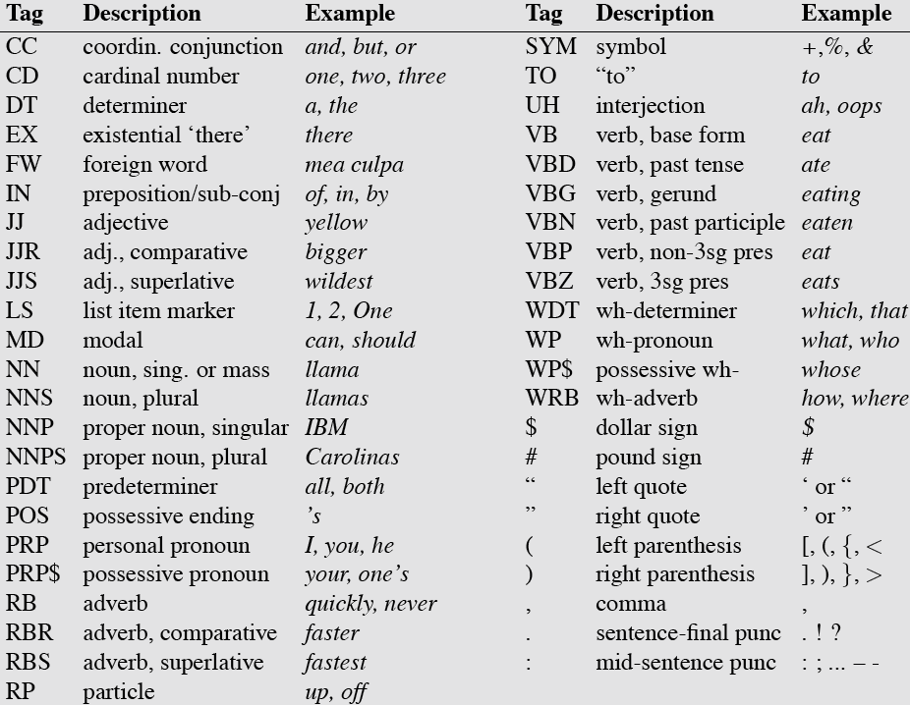
POS Tags Commonly Used in NLP

Slide 18
NLP Task: POS Tagging
The NLP task of automatically assigning POS tags to each word in a sentence/document is called POS tagging
Why is this a non-trivial task?
The same word can have different pos tags in different sentences or even in the same sentence:
His position was near the tree.
Position him near the tree.
Noun
Verb
John saw the saw and decided to take it to the table.
NOUN VERB DT NOUN CONJ VERB TO VERB PRP PREP DT NOUN

Slide 19
Why POS-tag?
Tagging reduces ambiguity
Words often have more than one POS: back
The back door = JJ
On my back = NN
Win the voters back = RB
Promised to back the bill = VB
A tagger should determine the one correct tag for a particular instance of a word in use.
These examples are from Dekang Lin
Notes:
It is a fact about all human languages (and not just English) that the same word can often have more than one part of speech; the correct one is determined by the syntactic context.
Take the word “back”.
Back can be an adjective (as in “the back door”
But it can also be a noun, the dorsal body part (as in “on my back”)
It can also be an adverb meaning returning location (as in “win the voters back”)
Or, it can be a verb that means “to support” (as in “promised to back the bill”)
The problem for an automated tagger is thus to select the correct POS tag for the particular instance of a word.

Slide 20
Types Beyond Words
Every language constrains what counts as a legal sequence of words
Constraints on the order and grouping of words are called “constituency” (e.g. phrases)

Slide 21
Phrase Structure
Most languages have a word order
Words are organized into phrases, group of words that act as a single unit or a constituent
[The dog] [chased] [the cat].
[The fat dog] [chased] [the thin cat].
[The fat dog with red collar] [chased] [the thin old cat].
[The fat dog with red collar named Tom] [suddenly chased] [the thin old white cat].

Slide 22
NLP Task: Phrase Chunking
Find all non-recursive noun phrases (NPs) and verb phrases (VPs) in a sentence.
[NP I] [VP ate] [NP the spaghetti] [PP with] [NP sauce].
[NP He ] [VP reckons ] [NP the current account deficit ] [VP will narrow ] [PP to ] [NP only # 1.8 billion ] [PP in ] [NP September ]
Some applications may need all (or only) the noun phrases of a sentence

